Slide 1




大灣區電子商務和數碼營銷實戰課程
課程費用: HK$4,950 (最高可獲得資助: HK$3,300)
*此為最高資助金額，資助款項以最終批核為準.
大灣區人口眾多，不少企業看準機遇想開拓這個龐大的消費市場。隨著大灣區的生活模式趨向數碼化，基本上生活中的大小事務都可在網上辦妥。大灣區雖充滿機會，但企業想要進軍，甚至在市場上站穩陣腳仍有一定難度。內地消費者的消費需求和喜好複雜及多元化，因此企業必須熟悉消費者的行為模式市場、內地媒體及文化風俗，才能適應這多變的市場。企業對於線上線下服務及體驗、宣傳渠道和大數據分析等都不能忽視。
資金充裕的企業，能輕易找個熟悉中國市場及有豐富經驗的公司，協助進軍大灣區市場。不過，對中小企來說就未必有資源聘請中國市場營銷專家。這課程旨在教授個人和本地企業打入大灣區消費市場，並善用資源分配到不同的市場方案，打造專屬及有效的市場策略。
課程編號 | TBC
日期及時間 | TBC 共12小時（每節3小時）
地點 | 九龍塘達之路78號生產力大樓
語言 | 廣東話
課程費用 | HK$4,950* (最高獲得資助港幣3,300元；2位或以上報名，可享團體優惠。請聯絡我們查詢詳細）
課程特色
本課程適合有意進入大灣區市場的人士和企業，並毋須具備營銷經驗。 學員將有機會在課程期建立自己的內地社交媒體賬戶、進行內容撰寫練習、進行直播等。 通過實戰環節，學員會更了解如何將這些技能應用到他們的業務中。
為確保學員掌握中國市場的最新動態，課程由熟悉市場趨勢、在品牌建設、電子商務、數字營銷方面經驗豐富且與中國服務商有廣泛聯繫的數碼營銷專家授課。
出席率75%或以上的學員，將獲頒發證書。
此課程已獲「再工業化及科技培訓計劃」認可，合資格學員最高可獲得2/3學費資助。
詳情請瀏覽：https://rttp.vtc.edu.hk 。

Slide 2


大灣區電子商務和數碼營銷實戰課程
課程內容
課堂 | 內容
課堂一 介紹大灣區營銷及建立社交媒體帳戶 | WHY 大灣區營銷的重要性和潛力 大灣區市場趨勢 WHERE & WHO 認識你的客戶（KYC）：大灣區消費者行為 選出適合市場和目標受眾 HOW 跨境電商渠道（小紅書、抖音、微信、B站、微博…）、電商平台（淘寶、京東商城…）、客服、廣告、物流、支付方式、限制等等 了解大灣區的社交和媒體趨勢 法律合規：中國電子商務法、知識產權 實戰環節：建立個人小紅書帳號及撰寫廣告文案
課堂二 市場策略 （KOL，KOC，直播） (小紅書企業帳號) | 微網紅、KOL、KOC 中國KOL、KOC 如何尋找合適的 KOL 和 KOC 建立自己的 KOL/KOC 小紅書企業帳號營運攻略 直播 直播能如何改善業務 直播的準備工作和物流管理 實戰環節：策劃或進行直播（如：帶貨）
課堂三 市場策略 （微信公眾號、小程序） 電子卷 Digital Coupon | 社交營銷（社交零售）：公共流量和私人流量 微信小程序 微信小程序介紹 它如何幫助業務並增加用戶粘性 設立公司微信公眾號 商業案例：CAFORMULA 加配坊 電子卷 實戰環節：實習微信公眾號推廣策略
課堂四 介紹天貓國際和小紅書店鋪 | 天貓國際和小紅書店舖 店鋪運營 内容營銷、算法推荐、數據分析、客服、客戶評價等 實戰環節：實習店舖站內站外宣傳策略
查詢 Ms KO | +852 2788 5087 | training_2213@hkpc.org

Slide 3








大灣區電子商務和數碼營銷實戰課程
馬嘉宏先生
馬先生畢業於香港中文大學新聞傅播學院首屆廣告社會科學碩士，並於電子商務及中國社交媒體行業已有十多年經驗。在2006年，馬先生獲邀擔任香港公開大學專業證書課程品牌管理科目的客席導師。馬先生在2010年聯合創辦WECHATBIZ 中國數字營銷及BN Marketplace電子商務平台 。他擅長於品牌戰略策劃，小紅書平台營銷，國內互聯網營銷與產品精准營銷等；並熟悉各大電商與流量平台模式，微信廣告及騰訊官方廣告代理，香港天貓官方機構TP服務商。
報名方法
請掃描QR code並完成網上報名及付款；或
請填妥報名表、連同劃線支票郵寄至香港生產力促進局: 九龍達之路78號生產力大樓三樓（收件人: Ms KO, DTD）。請於信封上註明課程名稱及編號。報名表請於https://www.hkpcacademy.org下載。
申請RTTP培訓資助
公司如需為僱員申請RTTP培訓資助，須於開課至少兩星期前於https://rttp.vtc.edu.hk/rttp/login 提交申請。另外，申請表連同證明文件亦可電郵至rttp@vtc.edu.hk 提交予秘書處。
阮文輝先生是香港電影界的資深製作人員及導師，在電影製作行業內擁有24年以上經驗。阮先生在動畫、CG製作、電影后期製作各方面擁有深厚的工作經驗，精通Maya、Softimage、Alias、Wavefront Explore等專業軟件。阮先生曾經參與諸多國際電影及電視劇的製作，包括中國首部CG電影《魔比斯環》、《朝花夕拾‧芳華絕代》、《十月初五的月光》、《暗色天堂》、《導火新聞線》、《桃姐》、《同謀》、《滿城盡帶黃金甲》、《長江7 號》、《越光寶盒》等。
查詢 Ms KO | +852 2788 5087 | training_2213@hkpc.org

Slide 4

Artificial Intelligence: Introduction to ChatGPT & Dall-E
The development of Artificial Intelligence (AI) has reached an explosive critical point, where it’s so powerful that it threatens to replace human being in the labour market. OpenAI's latest AI ChatGPT and Dall-E is capable of making legal contracts, medical diagnosis, business copywriting, customer service, story writing, or even academic papers, computer programs that invade computers, art generation, just to name a few. In fact, ChatGPT is a set of "text generation" technology, letting AI make judgments through the text you input, and produce corresponding responses. As ChatGPT becomes more mature, the search engine giant Google may be subversively affected too, and it is bound to affect the global entrepreneurial environment.
In this hands-on master course, you will learn how to harness the power of ChatGPT and Dall-E, a cutting-edge AI tool, to produce high-quality content for various occasions. Whatever industry you’re from, these new technologies will bring impacts that you’ve never imagined.
Upon completion of the course, you will have a fundamental understanding of how to use ChatGPT and Dall-E to produce high-quality content for business, automating your workload and saving you time and effort.
Programme Code | 10014258-01
Date & Time | 30, 31 Mar 2023 1900-2200
Venue | HKPC Building, 78 Tat Chee Avenue, Kowloon Tong
Medium | Cantonese
Course fee | HK$2,400 (Group discount will be offered to enrolment of 2 people or above, please contact us for details)
Course Highlight
One of the very few local courses conducted in Cantonese
Live ChatGPT & Dall-E demo and hands-on activities
Taught by industry veteran with 20 years of IT experience
Inquiry Ms KO | +852 2788 5087 | training_2213@hkpc.org

Slide 5
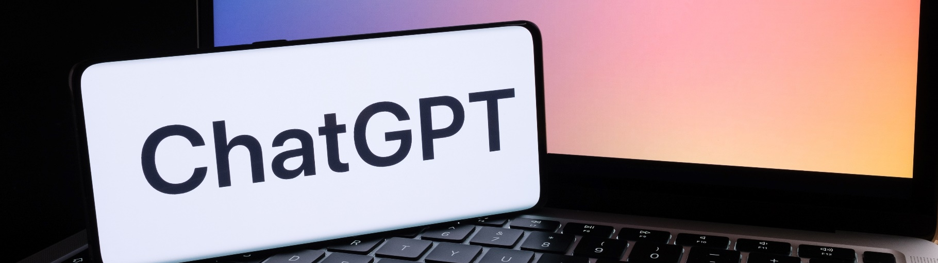

Generative AI Fast-Track: Master Cutting Edge Tools for Business Impact
The development of Artificial Intelligence (AI) has reached an explosive critical point, where it’s so powerful that it threatens to replace human being in the labour market. OpenAI's latest AI ChatGPT and Dall-E is capable of making legal contracts, medical diagnosis, business copywriting, customer service, story writing, or even academic papers, computer programs that invade computers, art generation, just to name a few. In fact, ChatGPT is a set of "text generation" technology, letting AI make judgments through the text you input, and produce corresponding responses. As ChatGPT becomes more mature, the search engine giant Google may be subversively affected too, and it is bound to affect the global entrepreneurial environment.
In this hands-on course, you will learn how to harness the power of ChatGPT, Grok, DeepSeek, a cutting-edge AI tool, to produce high-quality content for various occasions. Whatever industry you’re from, these new technologies will bring impacts that you’ve never imagined.
Upon completion of the course, you will have a fundamental understanding of how to use ChatGPT, Grok and DeepSeek to produce high-quality content for business, automating your workload and saving you time and effort.
Programme Code | P0000250/10017467-08
Date & Time | 21 & 23 Apr 2026 7:00pm to 10:00pm (Total 6 hours)
Venue | HKPC Building, 78 Tat Chee Avenue, Kowloon Tong
Medium | Cantonese
Course fee | HK$2,400 (Group discount will be offered to enrolment of 2 people or above, please contact us for details)
Course Highlight
One of the very few local courses conducted in Cantonese
Live ChatGPT, Grok & DeepSeek demo and hands-on activities
Taught by industry veteran with 20 years of IT experience
Inquiry Ms. WAI +852 2788 5794 | Ms. CHENG +852 2788 5010 | training_2213@hkpc.org

Slide 6
Generative AI Fast-track : Master Cutting-edge Tools for Business Impact
Course Outline
Session | Agenda
Session 1 (3 hrs) Getting Started with Generative AI | Understanding Generative AI Comprehend what Generative AI is and how it differs from traditional AI systems. Navigating the AI Model Landscape Gain insights into the practical differences between current AI models, including: OpenAI's GPT models (e.g., GPT-4o, GPT-4o-mini, o3, o4-mini) Google's Gemini Anthropic's Claude Elon Musk's Grok And other emerging models Introduction to Poe: Primary LLM Platform for the Course Learn how to utilize Poe effectively as the main platform for interacting with various LLMs: Understanding Poe's credit system and model access (free vs. paid tiers) Managing message context limits within Poe chats Overview of available model types in Poe (text generation, image generation, voice generation, video generation) Exploring key platform features such as public sharing and creator monetization (note: AI bot and app creation will be introduced at a high level only, not practiced in this course) Poe Platform Utilization: Practice accessing and managing different models within Poe.
Session | Agenda
Session 2 (3 hrs) Advanced Topics and Content Generation | Context Windows and AI Behaviour Delve into the concept of context windows and understand how they explain most unexpected AI behaviours. Memory Management in LLMs Understand how large language models manage memory and context, including their limitations. Selecting the Right Model and Tool Learn how to choose the appropriate model and tool tailored to specific business needs. Effective Prompt Writing Develop skills to write clear, structured prompts that control tone, style, format, and content scope. Hands-on practice: Write and refine prompts across various tones and formats. Generating Professional-Quality Business Writing Master the process of effortlessly creating high-quality business documents, ranging from short emails to full-length documents exceeding 10,000 words, using a proven, smart method. Visual Content Creation Acquire basic techniques for generating visuals through prompt-based image tools. Hands-on practice: Generate basic visuals using models supported by Poe. AI-Assisted Slide Presentations Learn how to transform text documents into structured, AI-assisted slide presentations. Hands-on practice: Create structured slides from text using AI assistance.
*Content in course outline is subject to change at the instructor's discretion
Inquiry Ms. WAI +852 2788 5794 | Ms. CHENG +852 2788 5010 | training_2213@hkpc.org

Slide 7
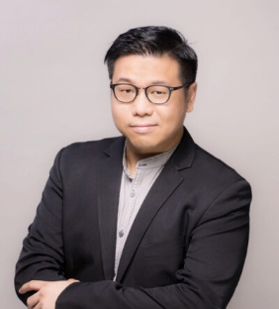

Generative AI Fast-track : Master Cutting-edge Tools for Business Impact
Mr Keith Li
Keith is the Co-Founder and Chief Executive Officer of Innopage Limited, a company specializing in Mobile Apps and Blockchain / Web3 projects development. Since 2010, under Keith's leadership, Innopage has received numerous local and international awards for its innovative products. In addition to his professional pursuits, Keith serves as a part-time lecturer at local universities. Currently, he also holds the position of Chairman of the Hong Kong Wireless Technology Industry Association (WTIA).
Enrolment method
Scan the QR code to complete the enrolment and payment online
Special discount for group enrolment of 2 or above and please contact Ms. Yan WAI at 2788 5794 or training_2213@hkpc.org for more details.
Inquiry Ms. WAI +852 2788 5794 | Ms. CHENG +852 2788 5010 | training_2213@hkpc.org

Slide 8
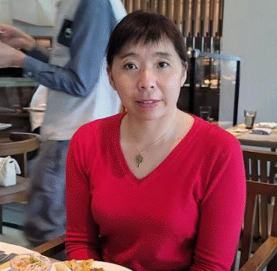
Blender 3D Modelling:
Open-Source Professional 3D Production
Student Testimonial
I attended HKPC's five-day workshop to learn Blender and benefitted greatly from it.
Many thanks to our tutor for teaching us. I received valuable experience from fellow students coming from different learning and teaching backgrounds.
I teach secondary level Visual Arts and I think Blender resembles Canvas. Both invite us to learn the wonders of 3D spaces using digital methods. I learnt how to sculpt characters, perform UV unwrapping on faces and apply textures.
From simply sticking stickers onto my own airplane model, to experimenting with set animation settings, my imagination was allowed to run freely beyond static paintings on paper.
In the future, I plan to enter a short film competition with a blender-made piece. By then, I believe that I will have a more thorough understanding of character modelling.
Ms. Angela Lai
Supporting Organisations (in alphabetical order)

